Slide 1

Joint Agency Commercial Imagery Evaluation (JACIE)
Civil Commercial Imagery Evaluation Workshop
September 24, 2019
Greg Stensaas, stensaas@usgs.gov
USGS Earth Resources Observation and Science Center (EROS)
JACIE Co-Chair

Slide 2
Welcome to the 18th JACIE Civil Commercial Imagery Evaluation Workshop
JACIE Workshop
  Booklet/Packet
    3 day agendas including speaker and presentation information including Bios & abstracts
    Survey: Recommendations and Comments
  Moderators/Facilitators provide/send presentations ahead of your session
JACIE - no registration fees – Government facilities –
Break - Some drinks and snacks provided for break – donations welcome
Lunch – on your own –
Recommend USGS Cafeteria out the door and down the hall, till you hit escalator on your right, go down to cafeteria on lower level
Logistics and Support
  Restrooms – Emergency exits
  Provide your presentations to Bobbi NLT the break before your session starts. Turn in presentation release form to Bobbi if you have not done so.

Slide 3
Joint Agency Commercial Imagery Evaluation (JACIE) Forum
JACIE provides the U.S. Federal Government with information about the data quality of remotely sensed data sources, including new civil and commercial systems/data/products
  JACIE Information Page – Everything back to 2001
  https://www.usgs.gov/land-resources/eros/calval/jacie
  http://calval.cr.usgs.gov/jacie/
JACIE data quality information
  Sensor details and calibration and System Characterization results including Geodetic /Geometric, Spatial, Radiometric, and Spectral accuracy, and product performance criteria
In addition to these, the JACIE partners are interested in technical factors that affect data quality, interoperability, and usability

Slide 4
JACIE Team
JACIE Co-chairs
  USGS: Gregory Stensaas
  NASA: Kurt Thome
  USDA: Dath Mita
  NOAA: Mitch Goldberg
  NGA: Dave Case
JACIE Stakeholders
  USGS: Tim Newman
  NASA: Brad Doorn
  USDA: Glenn Bethel/Ronald Franz
  NOAA: Mitch Goldberg
  NGA: Frank Avila
JACIE Technical Team – Jon Christopherson (lead)
JACIE Administration and Workshop Coordinator – Bobbi Jo Britt
Started in 2000 via NASA Commercial Data Buy with the need for better understanding of calibration and data quality
JACIE mission has always been to understand the Data Quality of Remotely Sensed Data sources
  JACIE scope expanding due to large number of civil & commercial remote sensing data and higher level products
Notes:
Meeting are held weekly

Slide 5
JACIE 2014 – Louisville, KY (ASPRS)

Slide 6
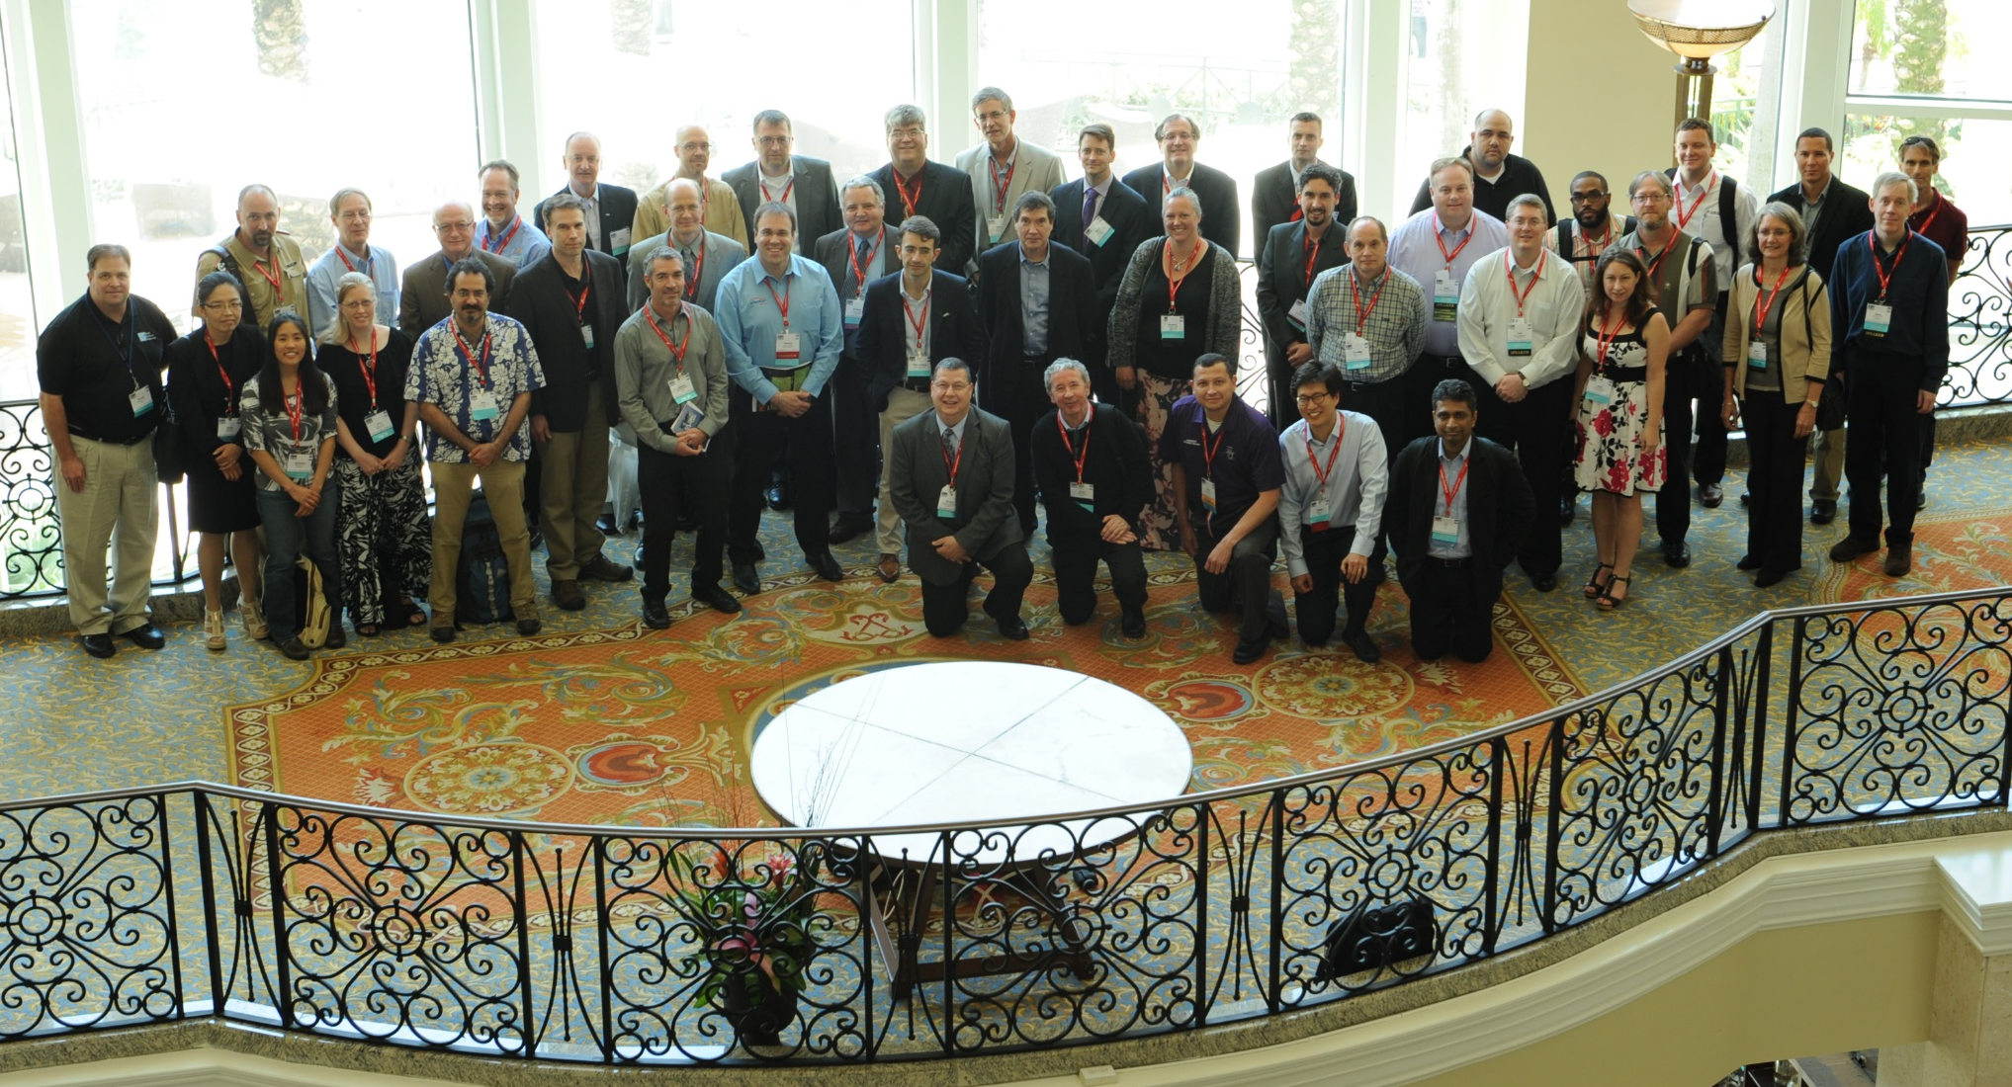
JACIE 2015 – Tampa, FL (ASPRS)

Slide 7
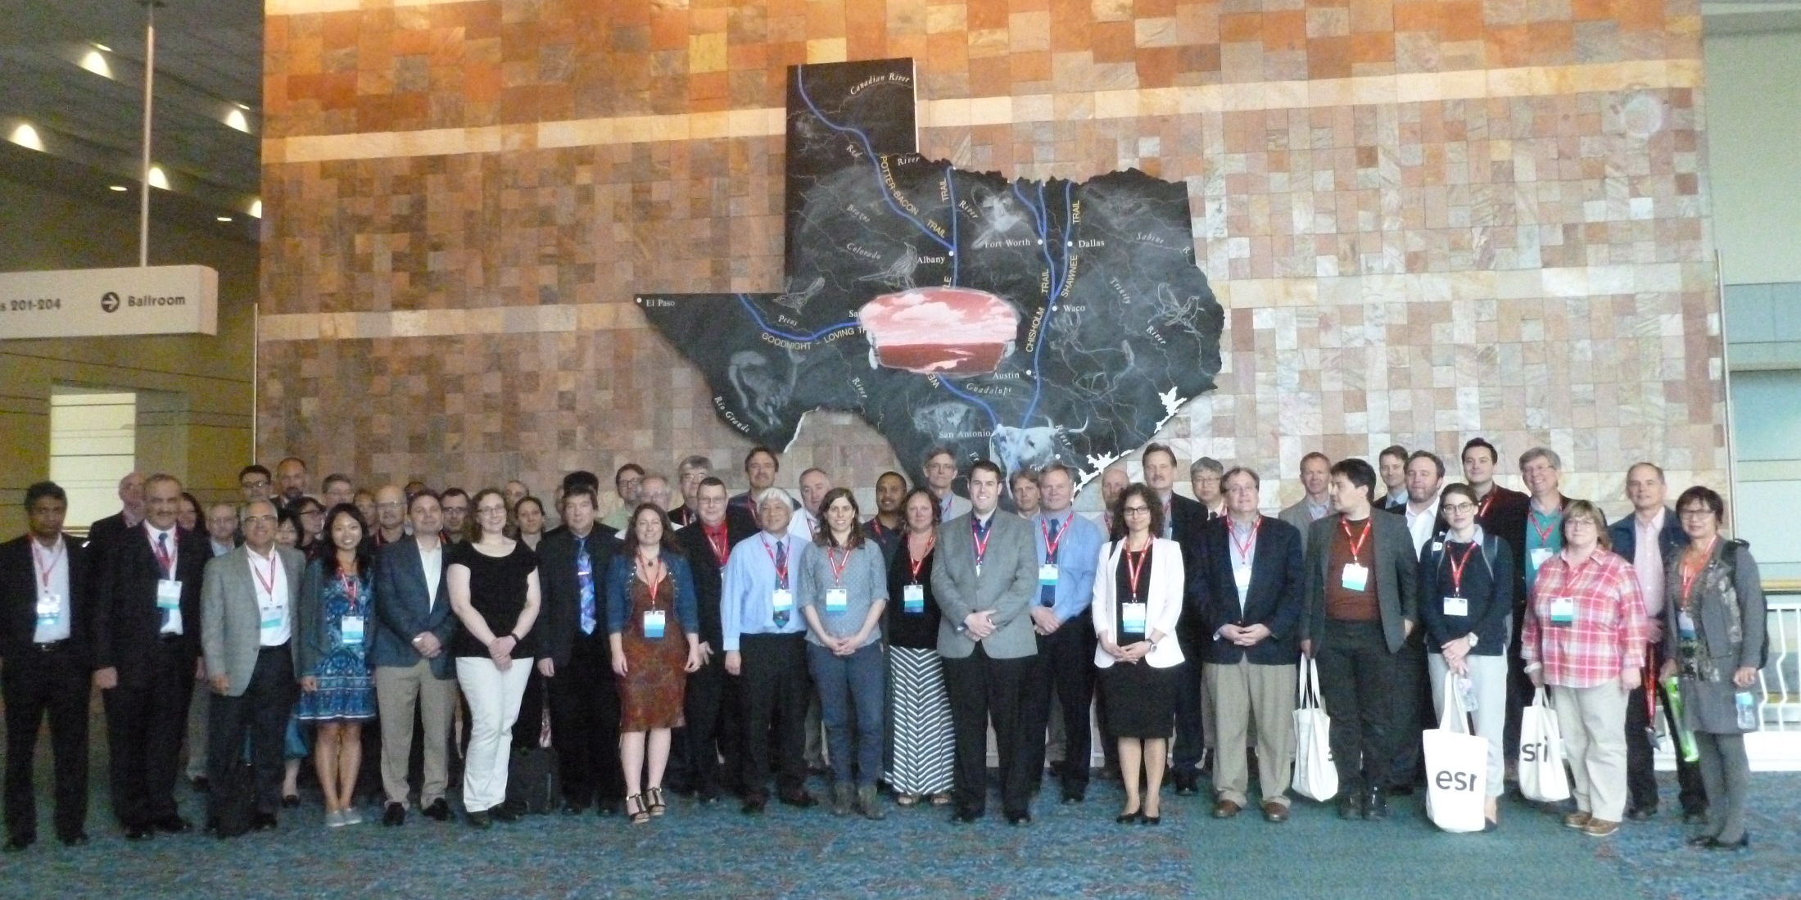
JACIE 2016 – Ft Worth, TX (ASPRS)

Slide 8
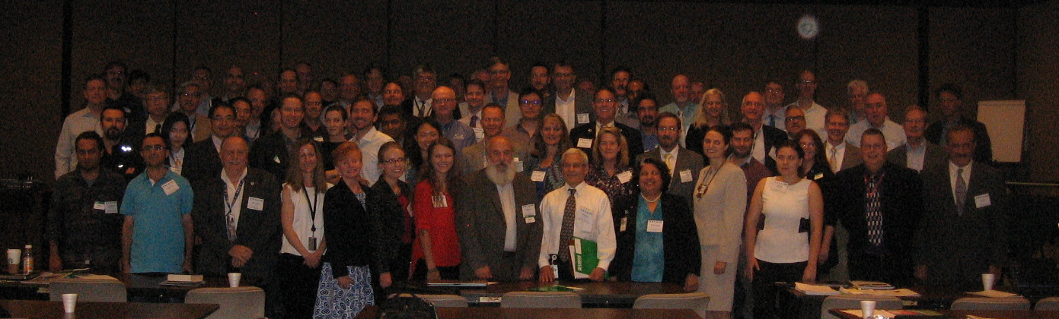
JACIE 2017 – Reston, VA (USGS)

Slide 9
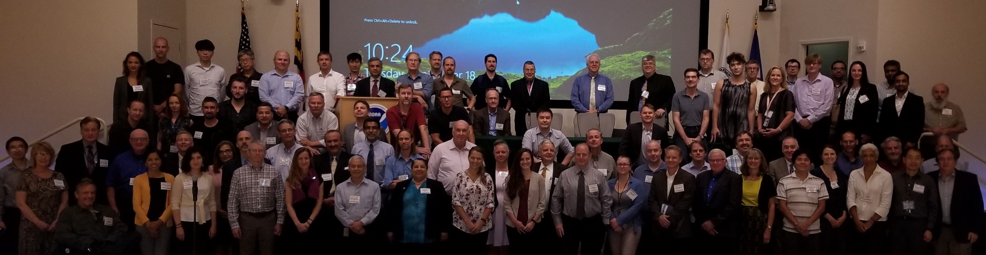
JACIE 2018 – College Park, MD (NOAA)

Slide 10
JACIE 2019 – Reston, VA (USGS)
Picture before lunch Today, Tuesday 9/24
Poster Session – Poster personnel will be available for discussion after the lunch break and before we begin afternoon session
  Please review and ask questions – POC is listed on poster – look them up
Survey Form – Please fill out and drop off at table with Bobbi

Slide 11
WiFi info
WiFi = IGSVisitor
Username: jacie
  OGS
Password: usgsusgs
  Desk1234

Slide 12
Government / Industry Panel Sessions
Session 1: Government Panel:
“Operating in a World of Multiple Data Sources”
9:00 AM (Moderator - Greg Stensaas)
Follow-up from JACIE 2018 - NOAA NESIS – comments provided by Dr. Mitch Goldberg
Government Panel:
-Mitch Goldberg, NOAA, Chief Scientist JPSS
Tim Newman, USGS, National Land Imaging Program Coordinator
Garick Gutman, NASA, LCLUC Program Director
Frank Avila, NGA, Director, Discovery & Assessment Office
Glenn Bethel, USDA, Remote Sensing Advisor
Session 5:
Wednesday, 8:30am-10:15am
Cooperation in Commercial Data
Amy Weaver, NGA and Paul Meund, NRO
ESA’s Earth Data Assessment Pilot: Paving the Way for New Space Players
Valentina Boccia, ESA-ESRIN
Sam Hunt, UK National Physics Laboratory
Session 6:
Wednesday, 10:30am -11:45am
PANEL SESSION: Moving Toward a Common Reporting Framework
Sam Hunt- NPL
Valentina Boccia, ESA ESRIN
Greg Stensaas, USGS
Ignacio Zuleta, Planet
Session 9:
USGS Director and Commercial Space Leaders (“Visions for Future Commercial and Government Remote Sensing”
8:30am-10:15am - (Moderator - Greg Stensaas)
Dr. James Reilly, USGS Director
Panel: Commercial Providers' Insights
Orla Dermody, Digital Globe
Robbie Schingler, Planet

Slide 13


Slide 14


Slide 15
Dear Greg,
Dear Raj,
I am glad to hear from you about these information. It would be great!
Enclosed please find the ppt slides and flyer.
It usually need take around one months for us to ship the print
materials to you. So, it seems late for us to ship them to you. I would
much appreciate that you could print them by yourself and send the
receipt to me via email. I am pleased to apply for reimbursement.
In addition, I would like to tell you that I have applied from our
manger that the papers from JACIE conference and PECORA conference
invited by you could get 50% discount. Please help pass this news during
the events. The authors could indicate that the paper was invited by you
at JACIE or PECORA to the Special Issue "Cross-Calibration and
Interoperability of Remote Sensing Instruments" in their cover letter
when they submit paper. Thus, our staff will waive 50% APC when we
receive their submission.

